Slide 1


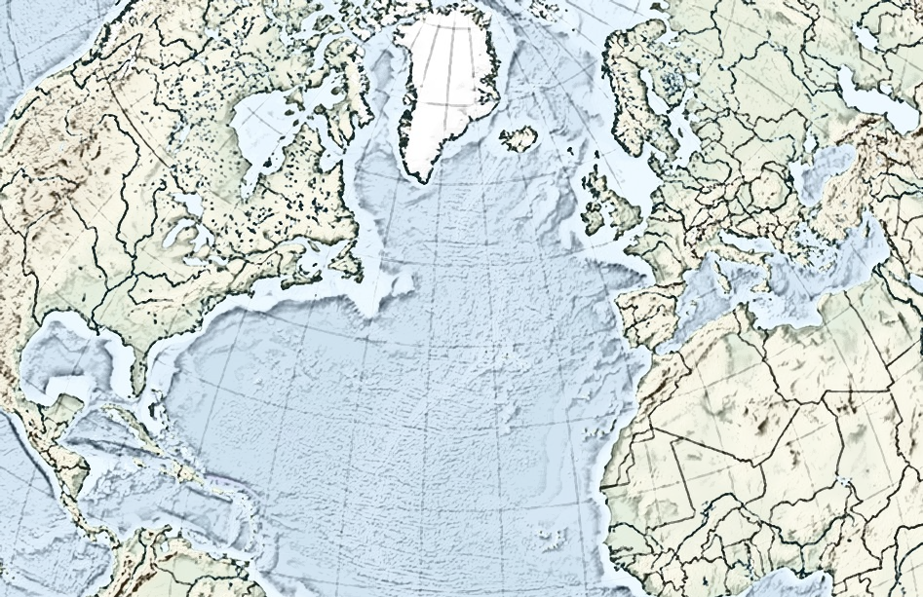
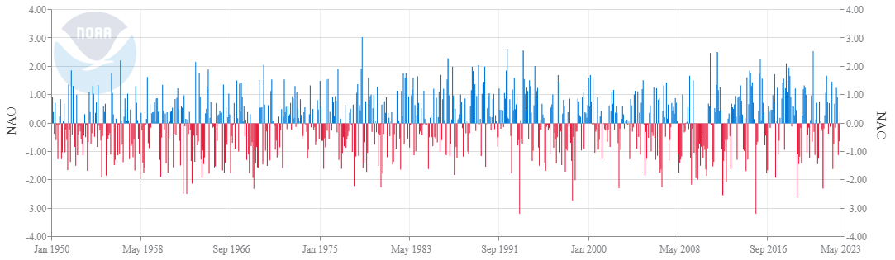
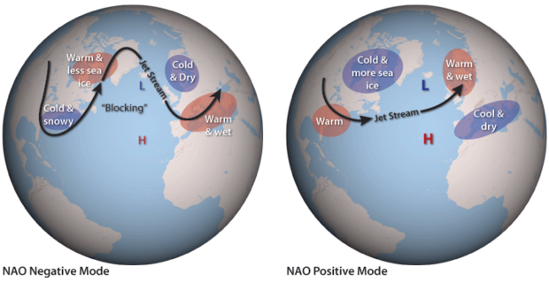
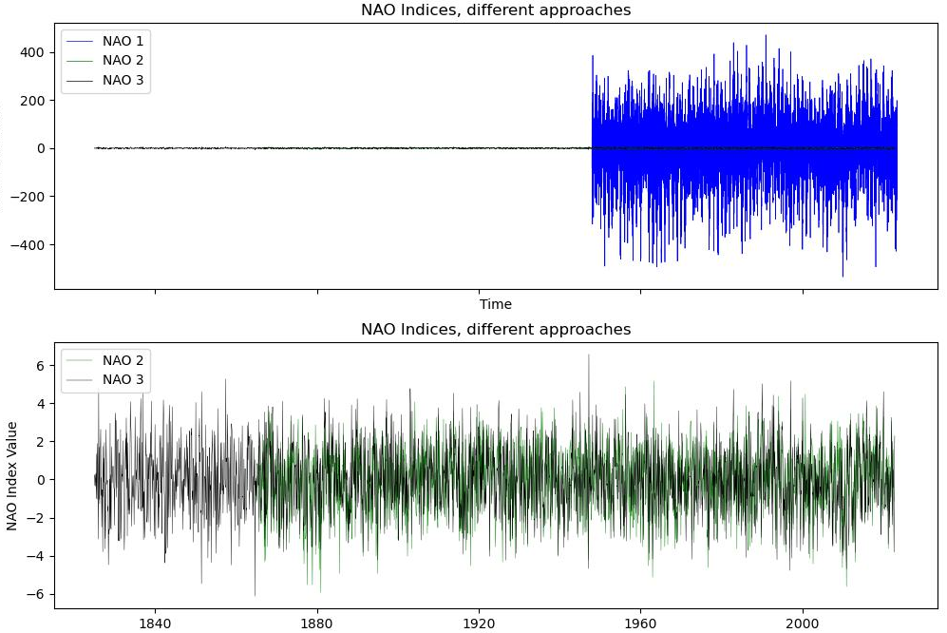
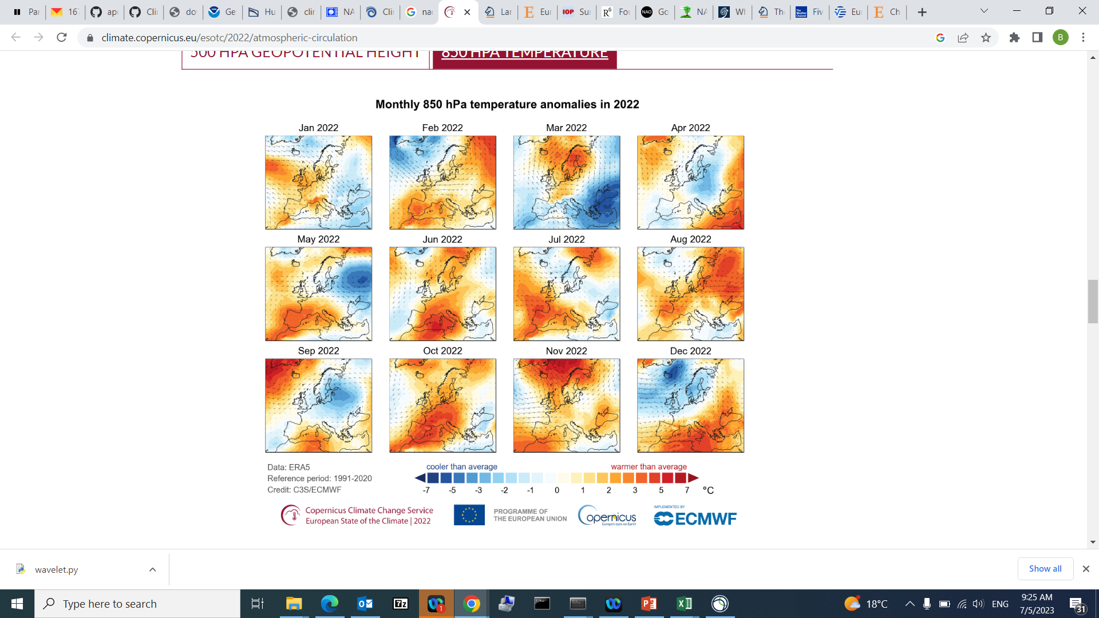

NAO: Scales and Applications
V. Volkova
climAPCREGION: Regional Climate Variability
The North Atlantic Oscillation (NAO) Index describes changes in the strength of two recurring pressure patterns in the atmosphere over the North Atlantic: a low near Iceland, and a high near the Azores Islands.
The most common NAO index is obtained by projecting the NAO loading pattern to the daily anomaly 500 millibar height field over 0-90°N. The NAO loading pattern has been chosen as the first mode of a Rotated Empirical Orthogonal Function (EOF) analysis using monthly mean 500 millibar height anomaly data from 1950 to 2000 over 0-90°N latitude. However, normalized sea level pressure differences (between e.g. Lisbon in Portugal and Reykjavik in Iceland) can be used as well, yielding station-based indices that go further back in time.
Source: [NOAA] https://www.ncei.noaa.gov/access/monitoring/nao/
Positive NAO index values indicate that pressure patterns are strong, creating a big pressure difference between highs and lows. Strongly positive values are linked to warm conditions across the U.S. East and Northern Europe, and cold conditions across southern Europe.
Negative NAO index values indicate that pressure patterns are relatively weak, and the pressure difference between highs and lows is smaller. Strongly negative values are linked to cold conditions in the U.S. East and Northern Europe, and warm conditions in Southern Europe.
Source [NOAA]: https://www.climate.gov/news-features/understanding-climate/climate-variability-north-atlantic-oscillation
Station-based indices (e.g. NAO2 and NAO3) allow to resolve the large-scale atmospheric dynamics further back in time, but since the observation stations are fixed in time, and NAO “centres of action” are usually not, there are at least 3 major issues with these indices: i) a large portion of interannual variability is lost, ii) long-term trends may not be correct, iii) smaller-scale fluctuations, not necessarily related to NAO, may be introduced
Why does it matter to us? Weather and climate prediction!
Example: Recent observations in Europe, 2022: During February and much of March, the NAO was strongly positive, influencing the stormy and windy conditions in northern Europe. In September, the negative NAO index contributed to much warmer-than-average conditions and surface melt in Greenland. The period of negative NAO Index in early December was favourable to colder-than-average conditions over northern Europe and warmer-than-average conditions over southern Europe.
NAO indices plotted together. NAO1: NOAA CPC, daily 1948-present, based on EOFs; NAO2: NCAR, Hurrell Station-Based Monthly Index, 1865-2022; NAO3: Climate Research Unit, University of East Anglia, also monthly, 1825-2022
Source [Copernicus]: https://climate.copernicus.eu/esotc/2022/atmospheric-circulation
3 indices, 3 wavelets
Closer look at last 20 years of the classic nao, possible connections to weather events, correlation with Kiel precipitation and temperature
References: I was inspired by Quinn’s and Felix’s codes

